Slide 1
CONSUMER SENTIMENTAL ANALYSIS

Slide 2
CONSUMER SENTIMENTAL
Another use case of customer sentiment analysis can be brand monitoring on all online platforms that can help you manage brand reputation better. For instance, monitoring and sentiment analysis of your brand mention on social media, product reviews, forums, etc. can help you quickly stop negative PR from escalating.

Slide 3
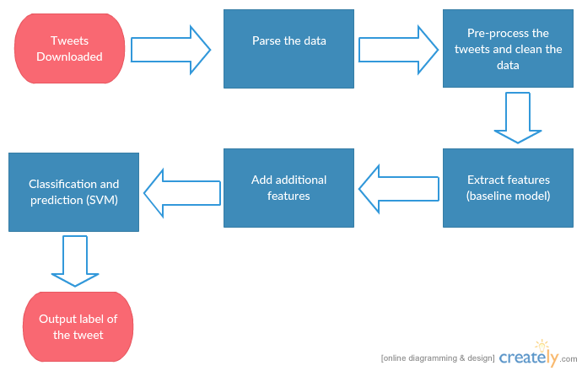

Slide 4
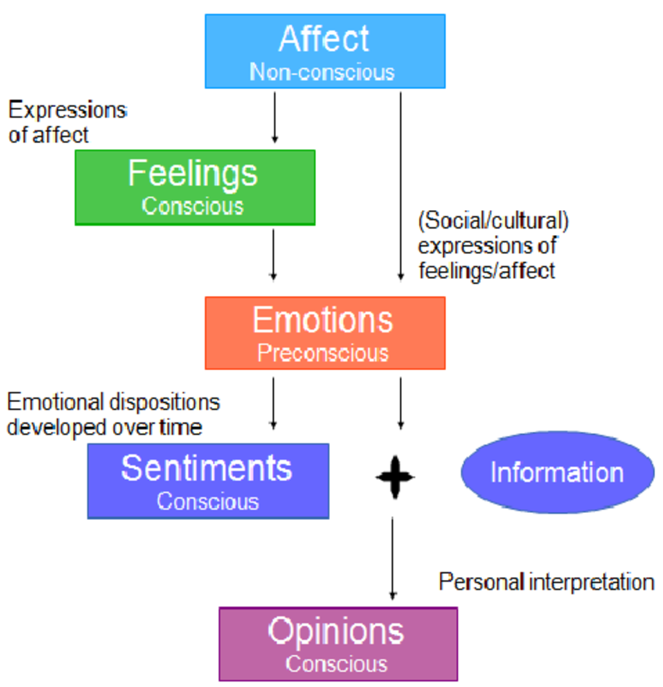

Slide 5
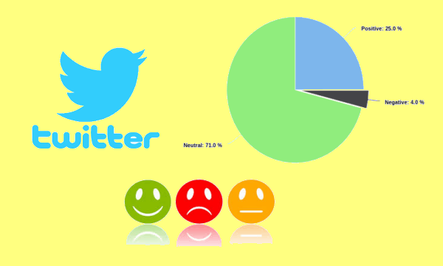

Slide 6
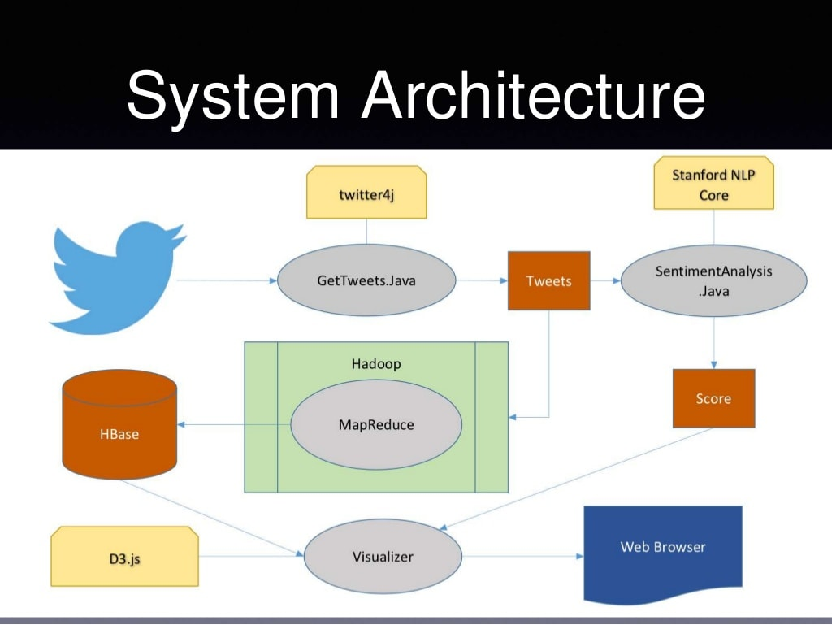

Slide 7
THANK YOU

